Slide 1


Linh Tong
08 September 2023

Slide 2

Outline
Executive Summary
Introduction
Methodology
Results
Conclusion
Appendix

Slide 3

Executive Summary
Methodologies: data collection, data wrangling, exploratory data analysis (EDA) using visualization and SQL, interactive visual analytics using Folium and Plotly Dash, predictive analysis using classification models
Results:
Launches with higher Payload Mass and Flight Number seemed to have better successful landing rate. However, in case of Payload, it may related to orbit type since only ISS, PO, VLEO have launches of higher load. In addition, VLEO flights all have over 60 attempts which results in good landing rate
Launch success yearly increased since 2013 to 2020
All 4 F9 Falcon lauch sites are located: near coastline, earth equator, railroad, highway but far away from cities for making use of the earth velocity, safety and effective transportation
Out of 4 algorithms tested, Decision Tree performed the best on train set. Nevertheless, the accuracy on the test set is the same for all model

Slide 4
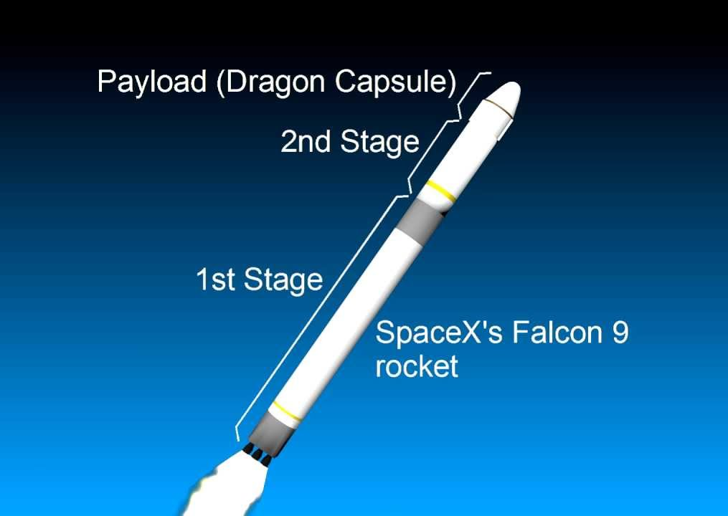
Introduction
Backgroud and context: SpaceX is a aerospace manufacturer and space transport services company founded by Elon Musk. The company develops the Falcon 9 rocket, which is capable of launching both crew and cargo to the International Space Station (ISS) with lower cost due to the resuse of the first stage.
Questions:
Can we predict if the Falcon 9 first stage will land successfully?
If so, what factors affect the likelihood of a successful landing?

Slide 5

Section 1

Slide 6
Methodology
Executive Summary
Data collection methodology:
Data was collected by sending requests to SPACEX API and parse as dataframe
Perform data wrangling
Describe how data was processed
Perform exploratory data analysis (EDA) using visualization and SQL
Perform interactive visual analytics using Folium and Plotly Dash
Perform predictive analysis using classification models
4 algorithms was used: Decision Tree, k-Nearest Neighbors, Support Vector Machine and Logistic Regression, parameters was tune using GridSearchCV, the models was evaluated by accuracy score

Slide 7
Data Collection – SpaceX API
Get the data using GET request to get rocket launch and rocket data from SpaceX API
Parse data to a dataframe
Filter to keep only Falcon 9 launches
GitHub URL of the completed SpaceX API calls notebook

Slide 8
Data Wrangling
Fill missing values
Create a landing outcome of the first stage column
0: did not land successfully
1: land sucessfully
PayLoadMass with the mean
LandingPad with None
GitHub URL of completed data wrangling related notebooks

Slide 9
EDA with Data Visualization
Scatter plot shows how Pay Load Mass, Launch Site, Flight Number related to the success of first stage landing
Scatter plot of how orbit type related to Success Rate, Flight Number and Pay Load Mass
Line plot shows the trend of yearly success from 2010 to 2020
GitHub URL of the completed EDA with data visualization notebook

Slide 10
EDA with SQL
Names of the unique launch sites in the space mission
5 records where launch sites begin with the string 'CCA’
Total payload mass carried by boosters launched by NASA (CRS)
Average payload mass carried by booster version F9 v1.1
Date when the first succesful landing outcome in ground pad was achieved
Names of the boosters which have success in drone ship and have payload mass greater than 4000 but less than 6000
Total number of successful and failure mission outcomes
Names of the booster_versions which have carried the maximum payload mass
records which will display the month names, failure landing_outcomes in drone ship ,booster versions, launch_site for the months in year 2015.
Rank the count of landing outcomes (such as Failure (drone ship) or Success (ground pad)) between the date 2010-06-04 and 2017-03-20, in descending order.
SQL queries performed to get the following information
GitHub URL of your completed EDA with SQL notebook

Slide 11
Build an Interactive Map with Folium
The map center at the USA with:
4 main markers of the launch sites
The popup markers of success/unsuccess event for each site
The lines show distance of one launch site to nearest coastline, railroad, highway and city
The aim for these maps is to show why the launch sites are located there and the success rate of each site
GitHub URL of completed interactive map with Folium map

Slide 12
Build a Dashboard with Plotly Dash
The Potly Dash dashboard include 2 types of charts
Pie chart:
Success count for all sites
Success rate for each site
Scatter plot shows correlation between pay load and success launch by booster version
All the charts have the drop down to choose launch site
The scatter plot has an extra slider to adjust the pay load range
GitHub URL of completed Plotly Dash lab

Slide 13
Predictive Analysis (Classification)
Model development process
Create numpy array of independent varibels (X) and dependent variable (Y)
Standardize X
Train-test split
Create a GridSearchCV object for each algorithms
Fit models
Calculate the accuracy score for train and test sets to determined the best model
GitHub URL of completed predictive analysis lab

Slide 14
Results
Exploratory data analysis results
Interactive analytics demo in screenshots
Predictive analysis results

Slide 15

Section 2

Slide 16
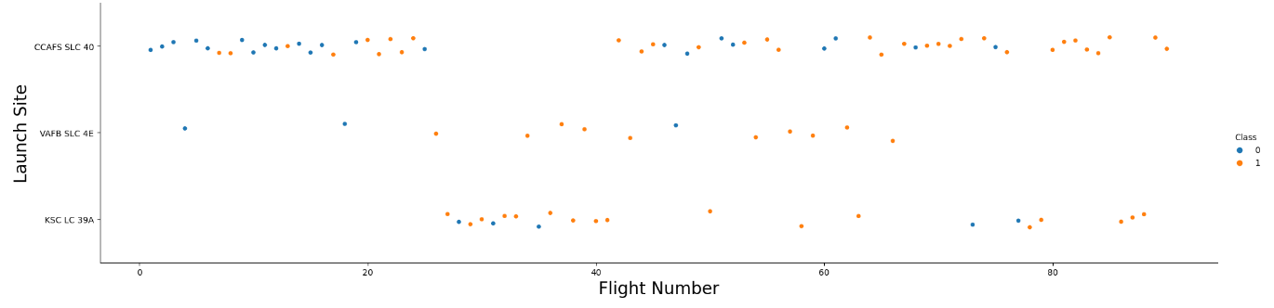
Flight Number vs. Launch Site
The higher Flight Number has higher successful rate regardless of the Launch Sites
It seemed liked Launch Site isn’t an important factor affecting landing outcomes

Slide 17
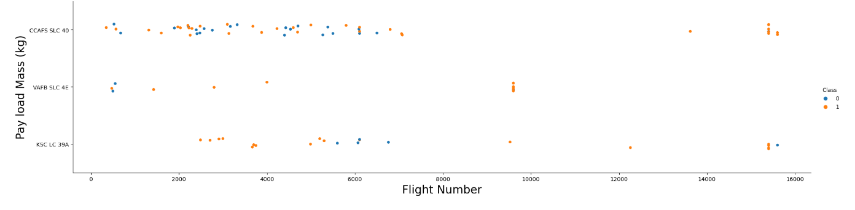
Payload vs. Launch Site
The higher Pay Load Mass (from 9000 to 16000 kg) has almost 100% successful rate regardless of the Launch Sites
Launch Site
Pay Load mass (kg)

Slide 18
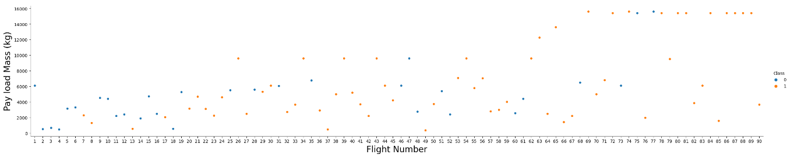
Payload vs. Flight Number
As the flight number increases, the first stage is more likely to land successfully. The payload mass is also important; it seems the more massive the payload, the less likely the first stage will return.

Slide 19
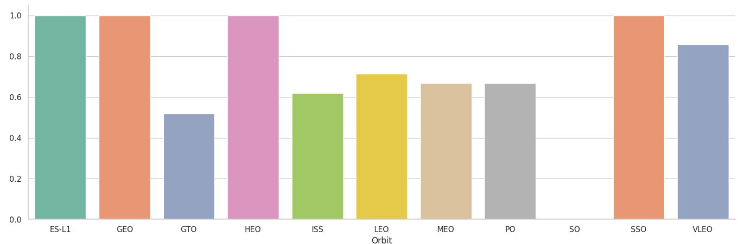
Success Rate vs. Orbit Type
ES-L1, GEO, SSO and HEO has perfect landing rate
SO stands last with no successful landing
Flight Number and Pay Load Mass found to affect landing outcome. How are those 2 features relationship with orbit?

Slide 20
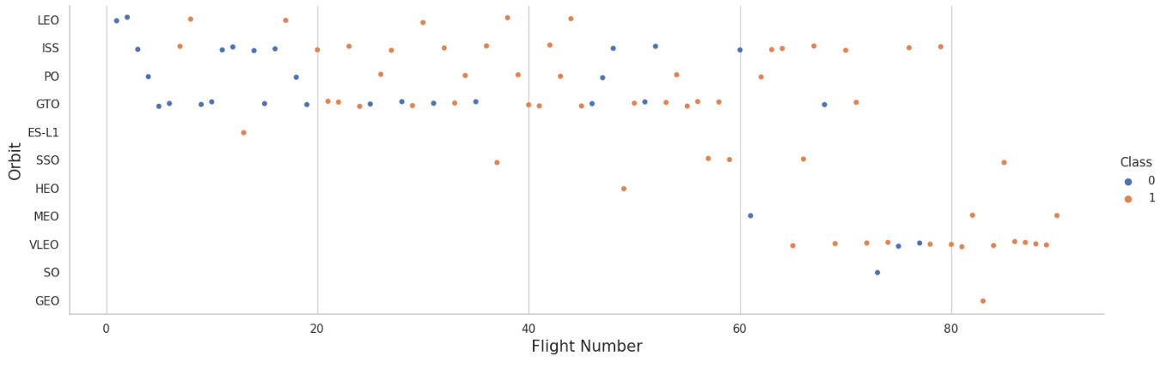
Flight Number vs. Orbit Type
ES-L1, GEO, HEO, SSO only have few launches compare to others so the perfect successful rates may be irrelevant. And so does SSO with only one launch (0% success)
With other orbit (except GTO) increasing flight numbers does seemed to boost successful landing

Slide 21
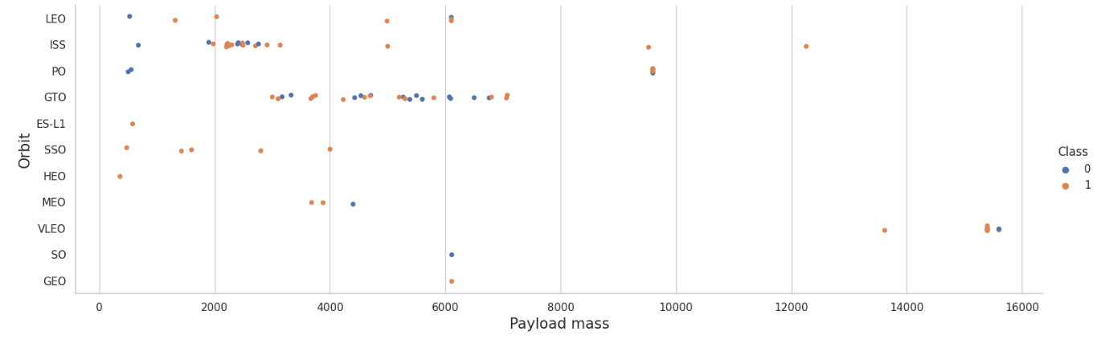
Payload vs. Orbit Type
With higher Pay Load Mass the positive landing rate are more for LEO and ISS

Slide 22
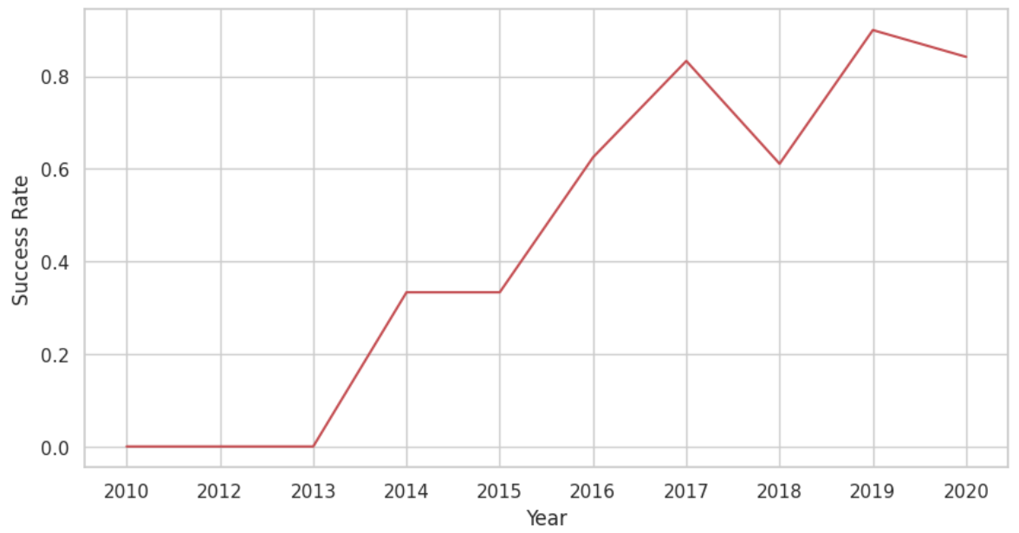
Launch Success Yearly Trend
The success rate keep increasing since 2013 till 2020

Slide 23
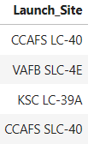
All Launch Site Names
Names of the unique launch sites:
CAFS LC-40
VAFB SLC-4E
KSC LC-39A
CCAFS SLC-40
Query: %sql SELECT DISTINCT Launch_Site FROM SPACEXTABLE

Slide 24
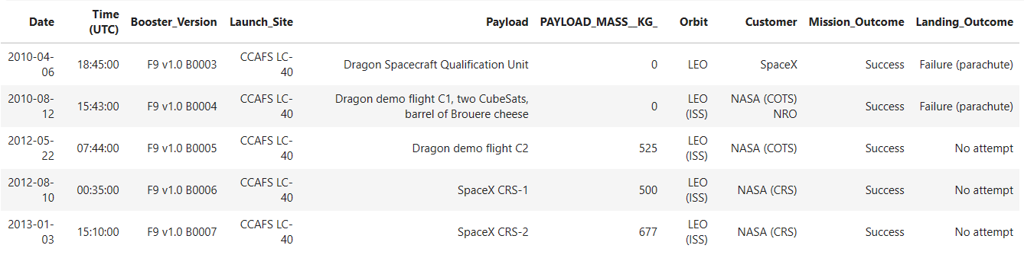
Launch Site Names Begin with 'CCA'
5 records where launch sites begin with `CCA`
Query: %sql SELECT * FROM SPACEXTABLE WHERE Launch_site LIKE 'CCA%' LIMIT 5

Slide 25
Total Payload Mass
The total payload carried by boosters from NASA is 45596 kg
Query: %sql SELECT SUM(PAYLOAD_MASS__KG_) FROM SPACEXTABLE WHERE Customer = 'NASA (CRS)'

Slide 26
Average Payload Mass by F9 v1.1
The total average payload mass carried by booster version F9 v1.1 is 2928.4 kg
Query: %sql SELECT AVG(PAYLOAD_MASS__KG_) FROM SPACEXTABLE WHERE Booster_Version = 'F9 v1.1'

Slide 27
First Successful Ground Landing Date
The dates of the first successful landing outcome on ground pad: 2015-12-22
Query: %sql SELECT MIN(Date) FROM SPACEXTABLE WHERE Landing_Outcome = 'Success (ground pad)'

Slide 28
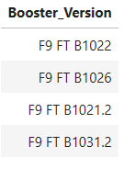
Successful Drone Ship Landing with Payload between 4000 and 6000
The names of boosters which have successfully landed on drone ship and had payload mass greater than 4000 but less than 6000
F9 FT B1022
F9 FT B1026
F9 FT B1021.2
F9 FT B1031.2
Query: %sql SELECT DISTINCT Booster_Version FROM SPACEXTABLE WHERE Landing_Outcome='Success (drone ship)' AND (PAYLOAD_MASS__KG_ BETWEEN 4000 AND 6000)

Slide 29
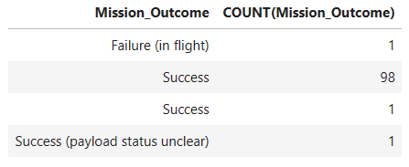
Total Number of Successful and Failure Mission Outcomes
The total number of successful and failure mission outcomes
Query: %sql SELECT Mission_Outcome, COUNT(Mission_Outcome) FROM SPACEXTABLE GROUP BY Mission_Outcome

Slide 30
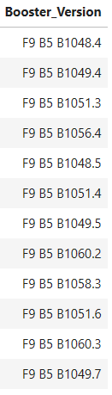
Boosters Carried Maximum Payload
List the names of the booster which have carried the maximum payload mass
Query: %sql SELECT DISTINCT Booster_Version FROM SPACEXTABLE WHERE PAYLOAD_MASS__KG_=(SELECT MAX(PAYLOAD_MASS__KG_) FROM SPACEXTABLE)

Slide 31
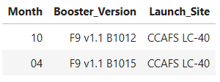
2015 Launch Records
The failed landing_outcomes in drone ship, their booster versions, and launch site names for in year 2015
Query: %sql SELECT SUBSTR(Date, 6, 2) AS Month, Booster_Version, Launch_Site FROM SPACEXTABLE WHERE SUBSTR(Date,1,4)='2015' AND Landing_Outcome='Failure (drone ship)'

Slide 32
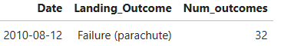
Rank Landing Outcomes Between 2010-06-04 and 2017-03-20
Rank the count of landing outcomes (such as Failure (drone ship) or Success (ground pad)) between the date 2010-06-04 and 2017-03-20, in descending order
Query: %sql SELECT Date, Landing_Outcome, COUNT(Landing_Outcome) AS Num_outcomes FROM SPACEXTABLE WHERE Date BETWEEN '2010-06-04' AND '2017-03-20’ ORDER BY Date DESC

Slide 33

Section 3

Slide 34
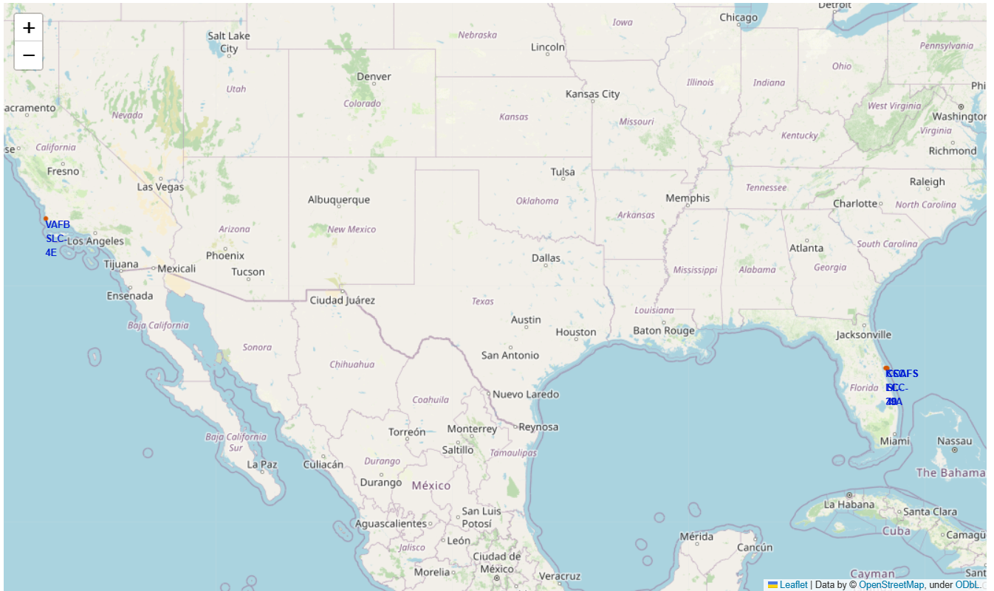
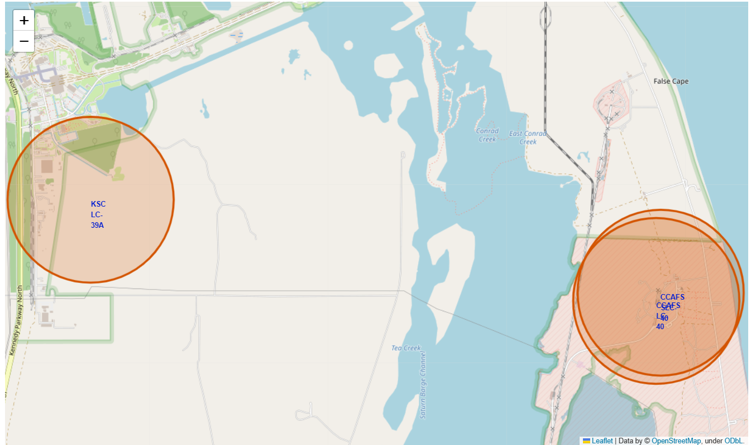
Folium Map of all Falcon 9 Launch Sites
There are 4 launch sites of Falcon 9 in the US:
3 on the the east side: CCAFS LC-40, CCCAFS LC-40, KSC LC-39A
1 on the west side: VAFB SLC-4E
All lauch sites are in very close proximity to the coast. This maybe be due to safety measures, if the lauch fail, the rocket could landed in the sea and cause no harm for the citizens.
The lauch sites are in proximity of the Equator line so it can take optimum advantage of the Earth's substantial rotational speed. Sitting on the launch pad near the equator, it is already moving at a speed of over 1650 km per hour relative to Earth's center.

Slide 35
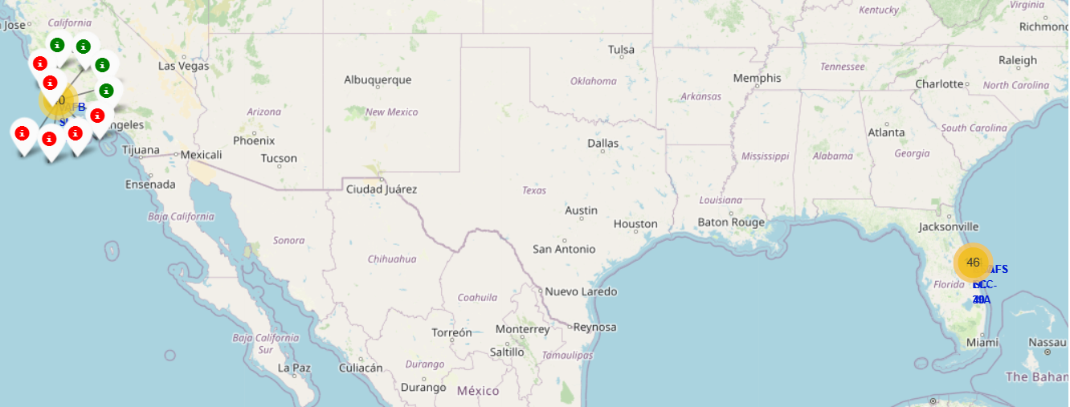
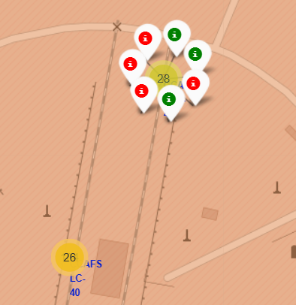
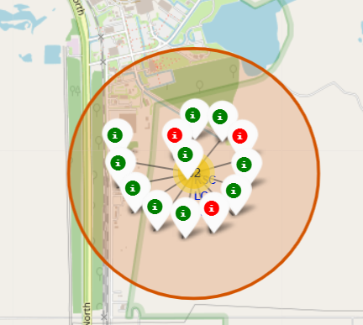
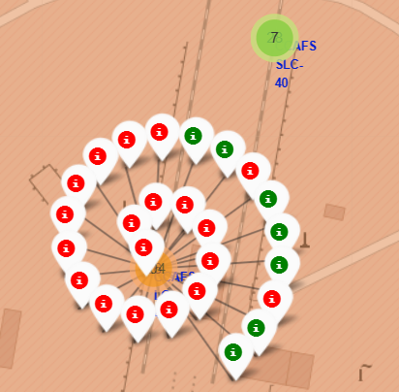
CCAFS LC-40
KSC LC-39A
VAFB SLC-4E
CAFS LC-40
Folium Map of all Falcon 9 Launch Sites outcomes
The outcomes for each site are colormap:
Red: fail landing
Green: successful landing
From the color-labeled markers in marker clusters, we should be able to easily identify the number of launches and which launch sites have relatively high success rates

Slide 36
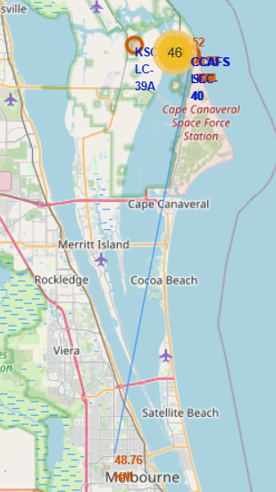
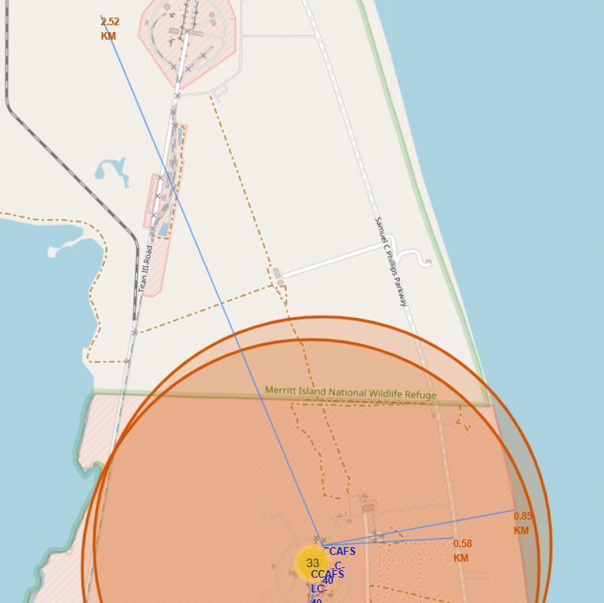
Distance from CCAFS LC-40 launch site to its proximities
Distance from CCAFS LC-40 launch site to its proximities including railway, highway, coastline
Launch sites are close to railways, highways and coastline but far away from cities for 2 reasons:
Safety: as being closed to coastline, if the mission fail and the crew need to escape, they can land on water
Transportation cost-effiency: as people, space ships and material such as fuel require to be at lauch site, being closed to railways and highways would cut down the cost.

Slide 37

Section 4

Slide 38
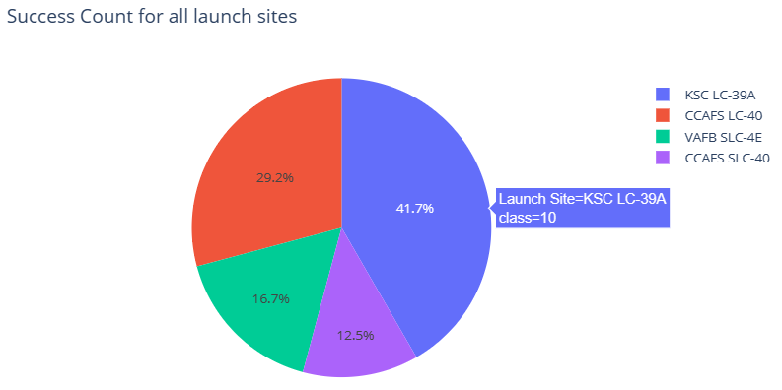
Launch success count for all sites
KSC LC-39A with 10 success launches and accounted 41.7% of all success launches for all sites

Slide 39
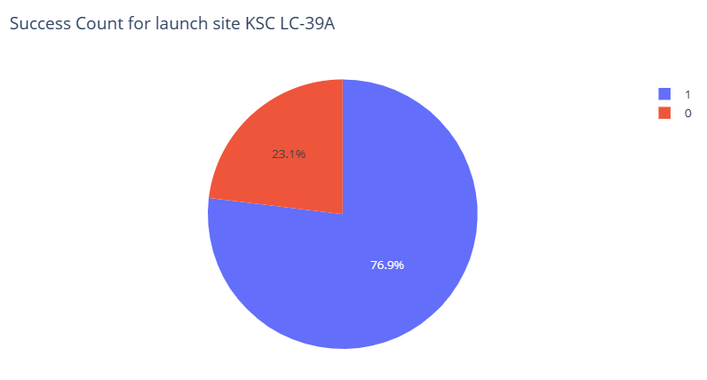
Site with highest launch success ratio
KSC LC-39A is also the site with the highest success ratio of 76.9%

Slide 40
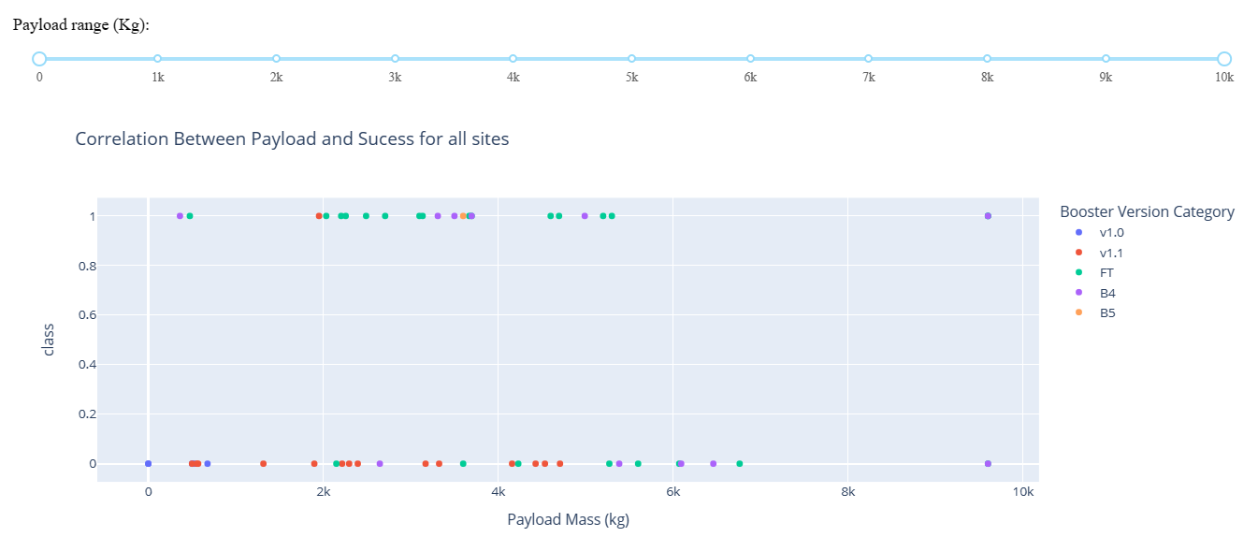
Payload vs. Launch Outcome scatter plot for all sites
Payload of 4000-4500 kg and 6000-7000 kg has the lowest launch success rate
Booster version B5 has only one launch and success which makes it 100% success rate. FT Booster have most of its launches successful

Slide 41

Section 5

Slide 42
Classification Accuracy
Decision tree model has the highest accuracy score for train set out of all 4 classification algorithms
Accuracy for the test set is the same for all models at 0.833.

Slide 43
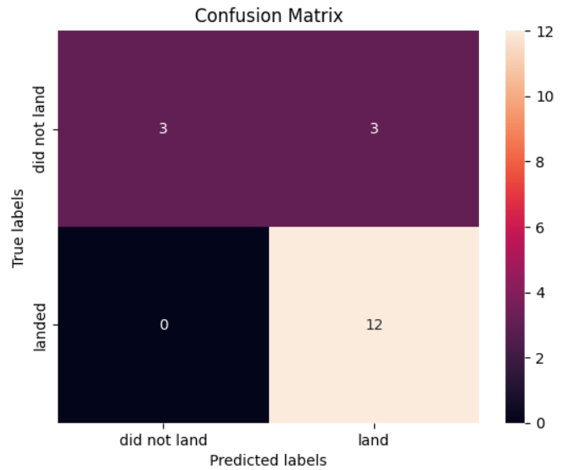
Confusion Matrix
Here is the confusion matrix for all 4 models
Accuracy is calculated as following
Accuracy = (TP + TN) / (TP + TN + FP + FN)
With TP: True Positive, TN: True Negative, FP: False Positive, FN: False Negative
For this case:
Accuracy = (12+3)/(12+3+0+3) = 0.833

Slide 44
Conclusions
Launches with higher Payload Mass and Flight Number seemed to have better successful landing rate. However, in case of Payload, it may related to orbit type since only ISS, PO, VLEO have launches of higher load. In addition, VLEO flights all have over 60 attempts which results in good landing rate.
Launch success yearly increased since 2013 to 2020
All 4 F9 Falcon lauch sites are located:
Near the earth equator so it can take optimum advantage of the Earth's substantial rotational speed
Near coastline and far from cities for safety
Near railway, highway and coastline to maximize transportation cost-efficiency
Out of 4 algorithms tested, Decision Tree performed the best on train set. Nevertheless, the accuracy on the test set is the same for all model. This may due to insufficient observations for the test set

Slide 45
Appendix
All the code and results for this report can be found via this GitHub URL
This presentation is the final project of IBM Applied Data Science Capstone

Slide 46


